Slide 1

Decoupling Classifier for Boosting Few-shot Object Detection and Instance Segmentation
Bin-Bin Gao¹, Xiaochen Chen¹, Zhongyi Huang¹, Congchong Nie¹, Jun Liu¹
Jinxiang Lai¹, Guannan Jiang², Xi Wang² and Chengjie Wang¹
¹Tencent YouTu Lab, ²CATL
Nov. 28— Dec. 9, 2022
Notes:
Hello，welcome everyone, this is Bin-Bin, from Tencent YouTu Lab, China.
I'm presenting our neurips twenty twenty-two paper with the title
Decoupling Classifier for Boosting Few-shot Object Detection and Instance Segmentation.

Slide 2



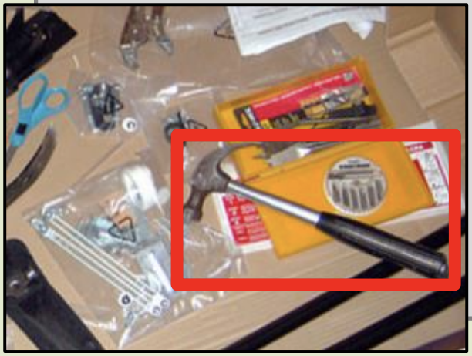
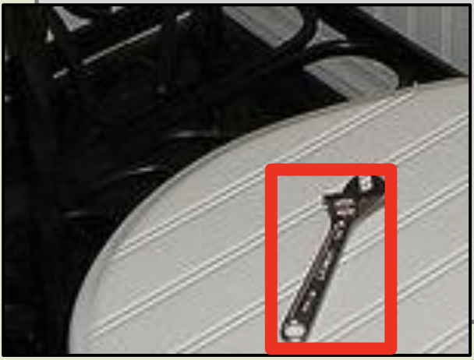
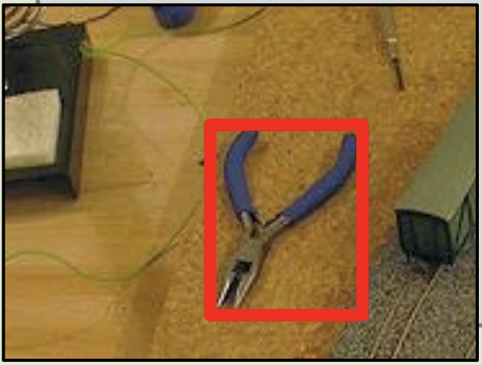
Introduction
Few-shot object detection/ instance segmentation
Few-shot object detection (FSOD) aims to detect novel objects with very few novel instances and abundant base instances.
General idea: a few-shot model should be able to transfer previous knowledge about base classes to help future detection tasks on novel classes.
base classes: abundant labeled instances
base training
stage
Person, Dog Car Bird
FSOD and FSIS
novel classes: very few labeled instances
novel training
stage
Hammer Wrench Pliers
Notes:
Let's start with a brief introduction to few-shot object detection and instance segmentation.
Few-shot object detection ﻿aims to detect novel objects with very few novel instances.
Few-shot instance segmentation generally follows few-shot object detection framework adding a mask segmentation head.

Slide 3

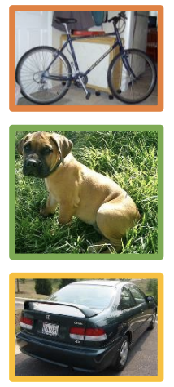
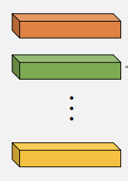
Introduction
Few-shot learning paradigm
Meta-learning paradigm aims to acquire task-level knowledge on base classes and generalize better to novel classes.
Query
RPN
RoI Align
Backbone
cls
Support
reg
shared
seg
Backbone
Global AvgPool
Meta RCNN, ICCV 19;
FSRW, ICCV 19;
FSDetView, ECCV 20;
TIP, CVPR 21;
FCT, CVPR 22;
⋯⋯
These methods suffer from a complicated training process (episodic training) and data organization (support-query pair).
Notes:
Most existing works can be roughly grouped into two paradigms, including meta-learning and transfer-learning.
The meta-learning aims to acquire task-level knowledge on base classes and generalize better to novel classes.
However, they usually suffer from a complicated training process and data organization, which results in limited applications.

Slide 4
Introduction
Few-shot learning paradigm
Transfer-learning mainly follows a fully supervised framework.
Base training
Novel Fine-tuning
RPN
cls
RoI Align
Backbone
reg
seg
TFA, ICML 19;
MPSR, ECCV 20;
FSCE, CVPR 21;
SRR-FSD, CVPR 21;
DeFRCN, ICCV 21;
FADI, NeurIPS 21;
⋯⋯
These transfer-learning methods is more simple and more efficient.
Notes:
In contrast, the transfer-learning mainly follows a fully supervised framework, which is more simple and more efficient.

Slide 5
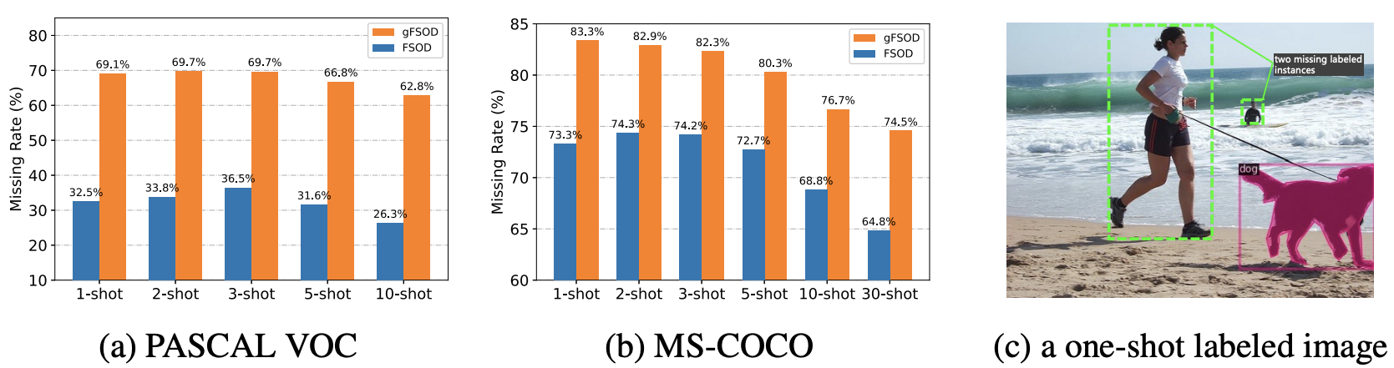
Motivation
Missing label issue
Instance-level few-shot setting: an instance as a shot for each class. This easily meets missing label issue.
Does a few-shot model learn well under missing label conditions?
Notes:
The community considers an instance as a shot in instance-level few-shot setting, which leads to missing label issue.
As shown in the Figure C, the two people instances are present in the image but missing annotations.

Slide 6
Motivation
Missing labele issue
Biased classification
Positive instances
reg
The box regression and mask segmentation heads only accept clear positive instances and thus no negative effects.
However, the classification head may be confused by missing labeled instances and thus results in a biased classification towards incorrectly recognizing foreground objects as background.
seg
cls
Negative
instances
Missing labeled
instances
Can we design a method to mitigate the biased classification?
Notes:
To analyze the effect of missing label, Let’s first revisit object detection or instance segmentation framework.
The bounding box regression and mask segmentation heads only accept clear positive instances and thus no negative effects.
However, the classification head may be confused by missing labeled instances and thus results in a biased classification.

Slide 7
Proposed Method
Decoupling Classifier
Positive Negative Missing labeled
Positive Negative Missing labeled
Positive Negative Missing labeled
Positive head
Classification head
Negative head
standard classifier
decoupling classifier
We propose a simple but effective method that decouples the standard classifier into two parallel heads to process clear positive instances and negative instances with missing labels.
Notes:
To mitigate the biased classification, we propose a simple but effective method that decouples the standard classifier into two parallel heads to process clear positive instances and negative instances with missing labels.

Slide 8
Proposed Method
Decoupling Classifier
Positive Negative Missing labeled
Positive head
Negative head
decoupling classifier
Positive head:
standard softmax function and cross-entropy loss.
Negative head:
The only change is to introduce an image-level label vector into the softmax function.
Notes:
For the positive head, we still use the standard classifier, which means using softmax function and cross-entropy loss.
For the negative head, the only change is to introduce an image-level label vector m into the softmax function.

Slide 9
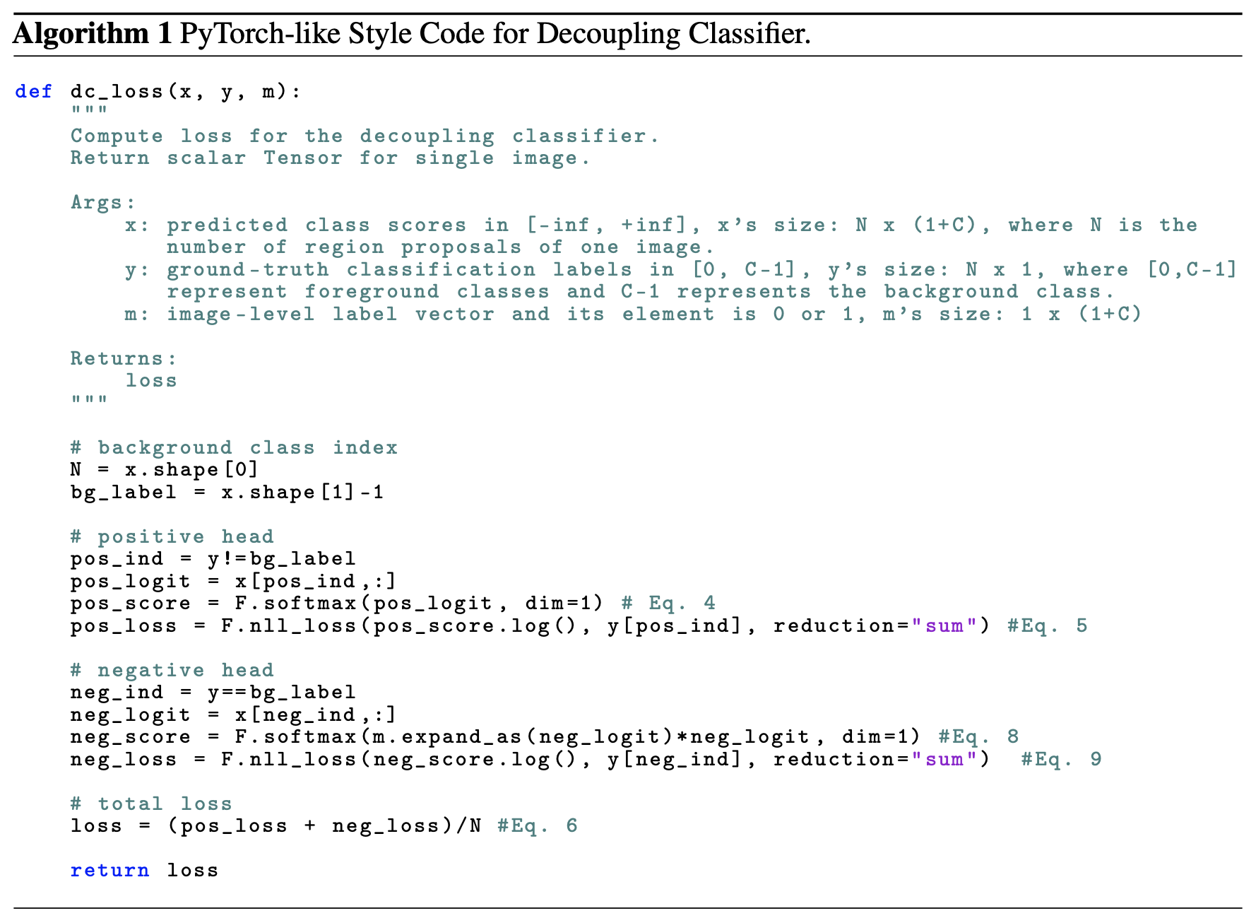
Proposed Method
The core code for decoupling classifier
The core implementation only uses one line of code but leads to
consistent improvements.
Notes:
Here, we give the core code of our decoupling classifier.
We can see that the core implementation only uses one line of code but results in consistent improvements.

Slide 10
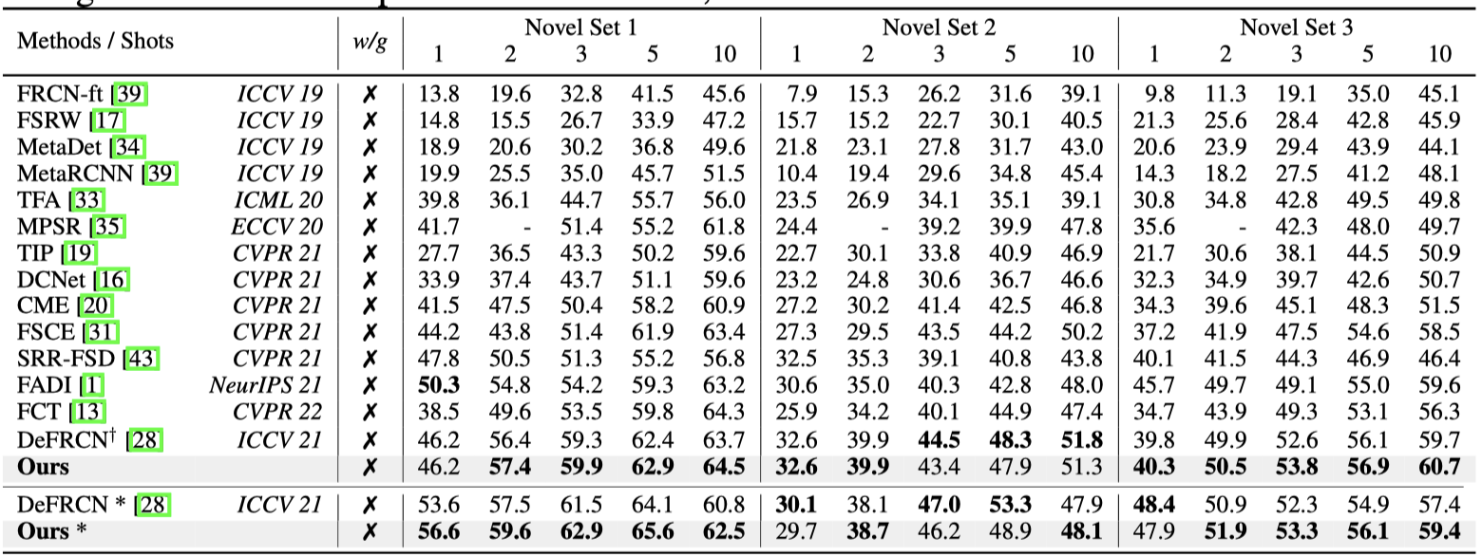
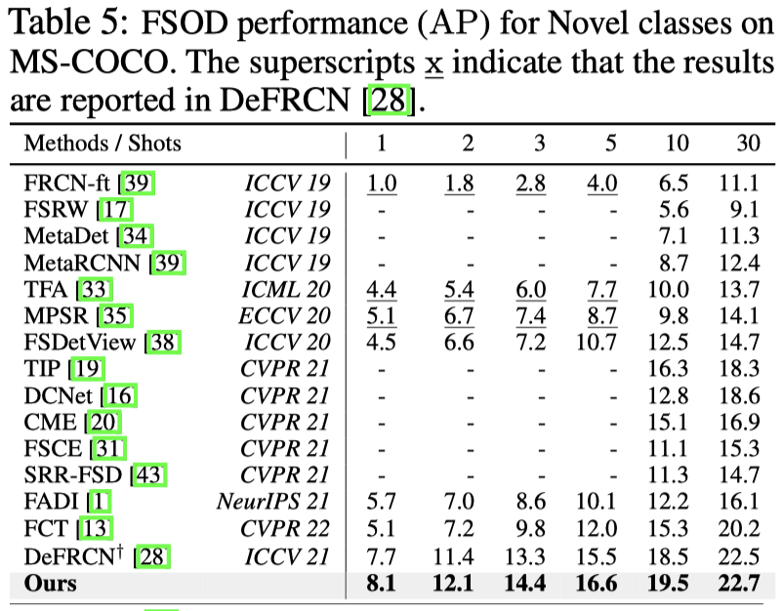
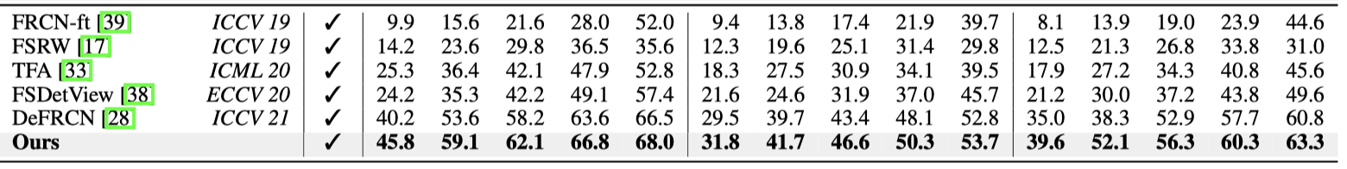
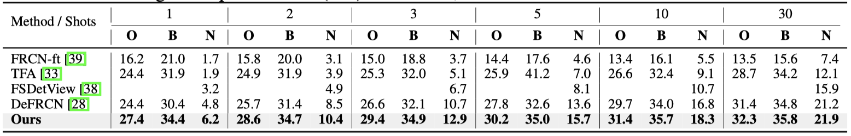
Experiments
Comparisons with state-of-the-arts
Table 1: Comparisons with SOTA FSOD methods on PASCAL-VOC. Table 2: Comparisons on MS-COCO
Table 3: Comparisons with SOTA gFSOD methods on PASCAL-VOC.
Table 4: Comparisons with SOTA gFSOD methods on MS-COCO.
gFSOD:
Our method significantly outperforms the SOTA by a large margin;
FSOD:
Ours method is also better than the SOTA under most cases.
Notes:
Our method achieves the state of the art performance on few-shot object detection and few-shot instance segmentation tasks.

Slide 11
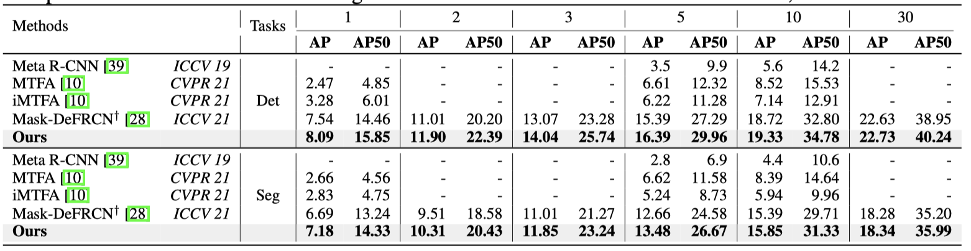
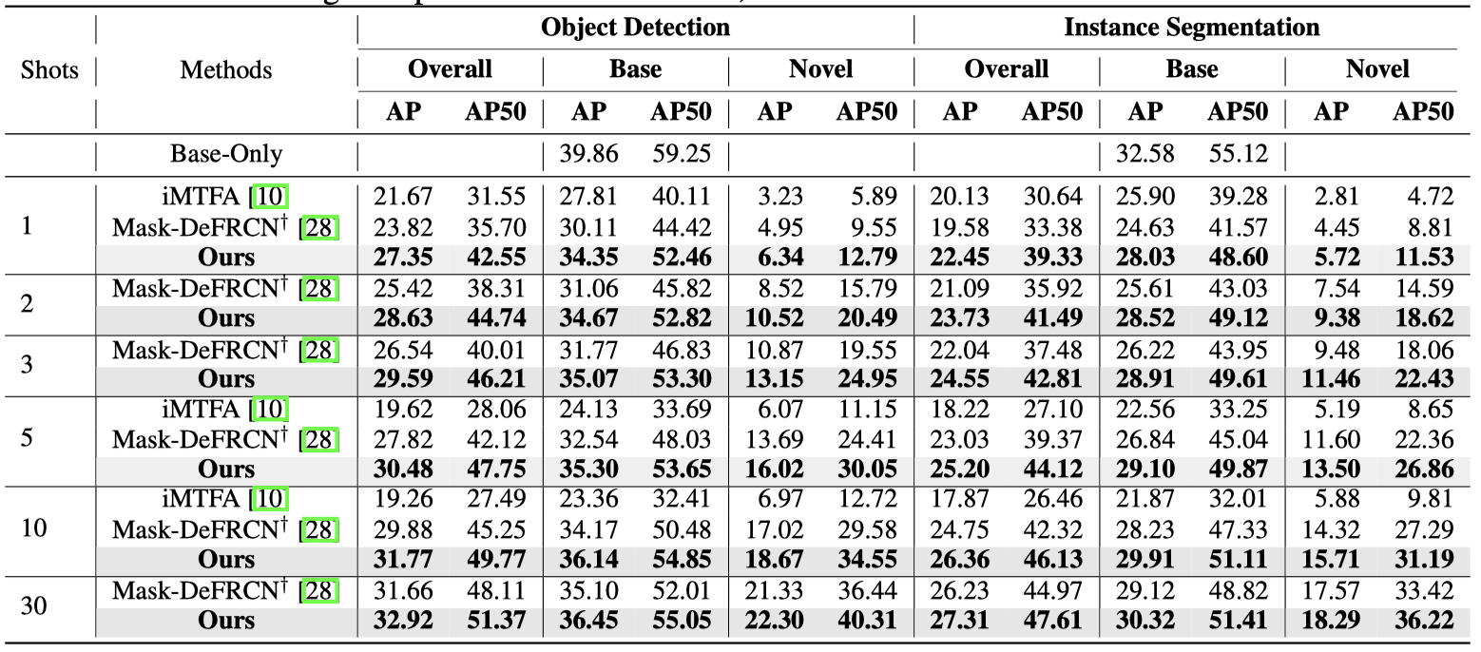
Experiments
Comparisons with state-of-the-arts
Table 5: Comparisons with SOTA FSIS methods on MS-COCO.
Table 6: Comparisons with SOTA gFSIS methods on MS-COCO.
Our method outperforms the SOAT on MS-COCO in either FSIS or gFSIS setting.

Slide 12
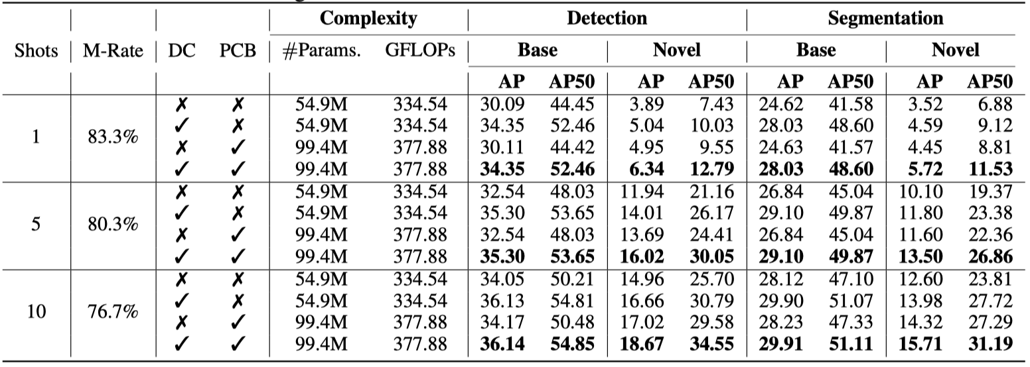
Experiments
Ablation study
Table 7: The effects of DC and PCB for FSIS performance on MS-COCO.
Effectiveness:
The decoupling classifier is effective not only on novel classes but also on base classes;
Efficiency:
The decoupling classifier is more efficient because of no additional parameters or computation cost.
Notes:
In addition, we conduct ablation studies.
As reported in the table, our decoupling classifier is effective not only on novel classes but also base classes.
Furthermore, the decoupling classifier is very efficient because of no additional parameters[pəˈræmɪtəs]or computation cost.

Slide 13
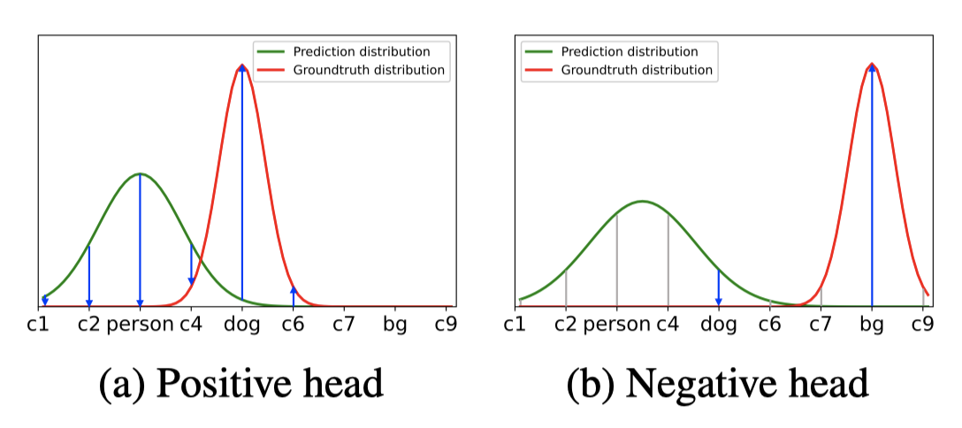
Discussion
Why does the DC work well?
Gradient optimization:
Positive head:
Negative head:
Positive head: the gradient is updated in each dimension of the class space.
Negative head: the gradient is limited in some special dimension because of the introduced and thus the biased classification may be alleviated.
Notes:
Why does the decoupling classifier work so well? we try to understand from two aspects.
Compared to the positive head, the gradient of the negative head is limited in some special dimensions and thus the biased classification may be alleviated [/əˈliːvɪˌeɪt/].

Slide 14
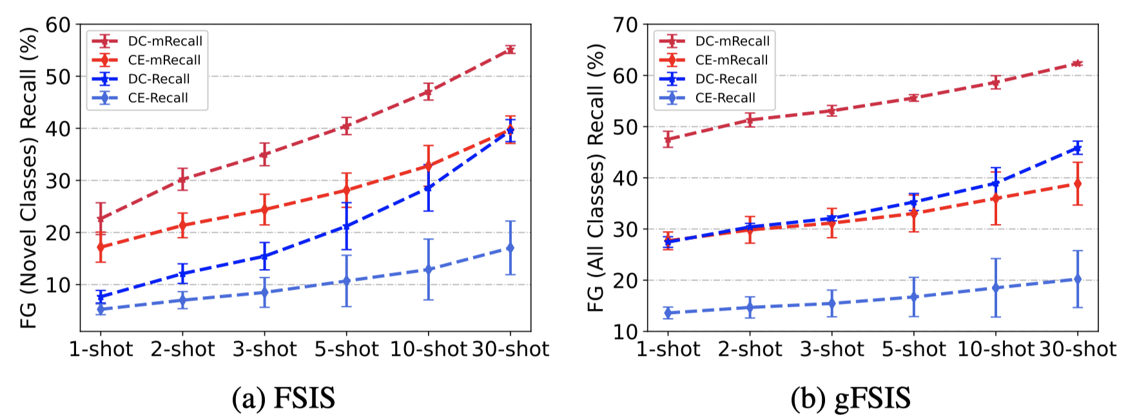
Discussion
Why does the DC work well?
Generalization ability (Reacll and mRecall):
The mRecall and Recall of our decoupling classifier is significantly higher that of the standard classifier on each shot with two few-shot settings. This means that the decoupling classifier is helpful to mitigate the bias classification thus boosting instance-level few-shot performance.
Notes:
Furthermore, the Recall values of our decoupling classifier is significantly[sɪɡˈnɪfɪkəntli] higher than that of the standard classifier as shown in the figure.
This means that the decoupling classifier is helpful to mitigate the biased classification thus boosting the instance-level few-shot performance.

Slide 15
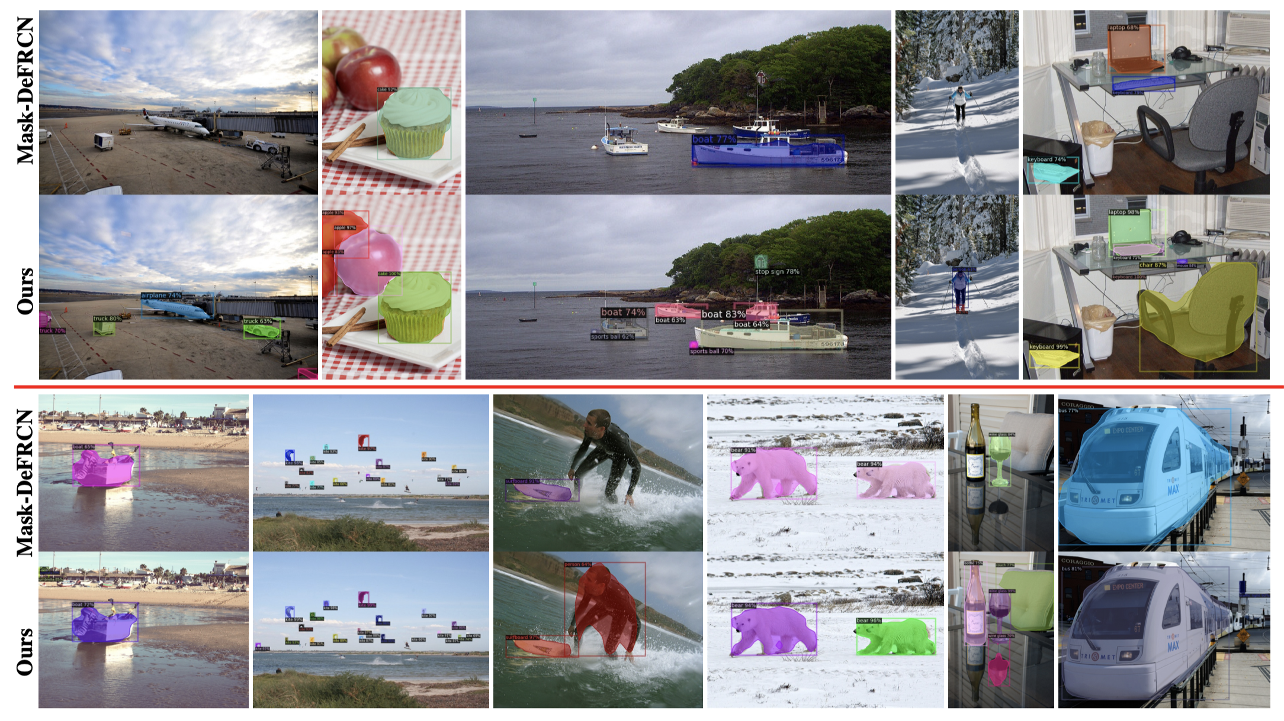
Discussion
Qualitative Evaluation
The baseline (Mask-DeFRCN) could fail to detect some objects, because it may tend to incorrectly recognize positive objects as background. However, the bias classification is well mitigated using our method, and thus better detection results are obtained.
Notes:
Here, we show some qualitative results with 10-shot setting.
We can see that the baseline method fails to detect some objects.

Slide 16
Conclusions
We rethink instance-level few-shot methods from the perspective of label completeness and discover that existing few-shot methods severely suffer from bias classification.
We propose a simple but effective decoupling classifier for mitigating the bias classification in instance-level few-shot settings.
We achieve state-of-the-art results on two instance-level few-shot tasks without any additional parameters and computation cost.
Notes:
Finally, I give a short summary. In this paper, we mainly have three contributions:
First, we rethink instance-level few-shot methods from the perspective of label completeness and discover that existing few-shot methods severely suffer from bias classification.
Second, we propose a simple but effective decoupling classifier for mitigating the bias classification in instance-level few-shot settings.
Third, we achieve state-of-the-art results on two instance-level few-shot tasks without any additional parameters and computation cost.

Slide 17
Thanks！
Notes:
Thanks for your attention and welcome to discuss with us for more details in the poster session.

